Slide 1





Closing Price Prediction using Sentiment Analysis by LLM & SSA
Netural Language Processing ( NLP )
Date: 27-11-2024

Slide 2




Presented To:
Md.Firoz Hasan
Lecturer (Senior Scale)
Department of
Computer Science and Engineering
Presented By:
Jannatul Ferdous Riva
ID: 221-15-4928
Batch: 61_A
Department of
Computer Science and Engineering
BACK
NEXT

Slide 3

Outline
01
02
03
04
Introduction
Research Objective
Literature Review
Methodology
05
06
07
Experimental Analysis
Conclusion
Reference
BACK
NEXT

Slide 4



Introduction
Predicting stock prices is challenging because financial markets are highly dynamic and unpredictable. This project improves stock price predictions by combining advanced sentiment analysis using fine-tuned Large Language Models (LLMs) with a Long Short-Term Memory (LSTM) model. It also uses a novel optimization method called the Sparrow Search Algorithm (SSA) to enhance the model’s accuracy. These techniques are applied to predict Tesla’s stock price, demonstrating better results compared to older methods.
BACK
NEXT

Slide 5

Research Objective
To predict Tesla's stock closing price accurately using advanced methods.
To use a fine-tuned Large Language Model (LLM) for better sentiment scoring.
To apply LSTM networks to capture time-based patterns in stock prices.
To optimize the LSTM model using the Sparrow Search Algorithm (SSA) for better performance.
BACK
NEXT

Slide 6
Litrature Review
Topic | Method/Tool | Description | Reference
Sentiment Analysis | VADER | A dictionary-based sentiment analysis tool that classifies text as positive, negative, or neutral. | Shihab Elbagir and Jing Yang 2
 | Large Language Model (LLM) | Advanced AI models fine-tuned for Tesla-related sentiment analysis. | Humza Naveed et al. 3
LSTM Model | Long Short-Term Memory Networks (LSTM) | A neural network model that captures long-term dependencies in time-series data. | Greg Van Houdt et al. 5
Optimization | Sparrow Search Algorithm (SSA) | Bio-inspired optimization technique mimicking the foraging behavior of sparrows. | Jiankai Xue and Bo Shen 7
Evaluation Metrics | Accuracy | Measures the proportion of correctly classified instances in a dataset. | Antonio Menditto et al. 8
 | Balanced Accuracy | Adjusted accuracy metric that accounts for imbalanced datasets by averaging individual class accuracies. | Kay Henning Brodersen et al. 9
 | Mean Squared Error (MSE) | Measures the average squared differences between predicted and actual values in regression tasks. | Timothy O. Hodson et al. 10

Slide 7
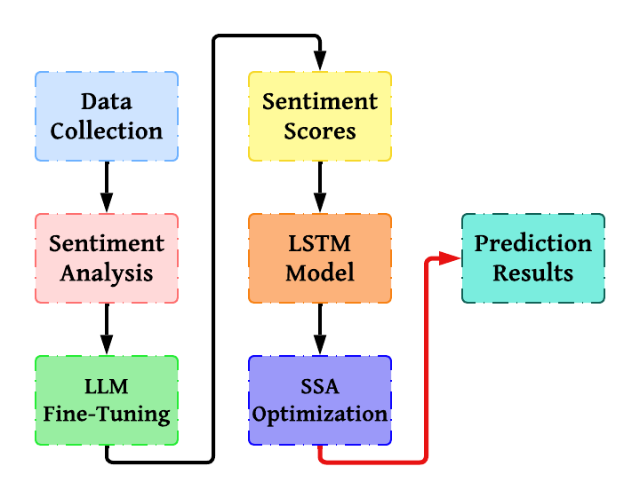
Methodology
BACK
Figure: Methodology Diagram
NEXT

Slide 8
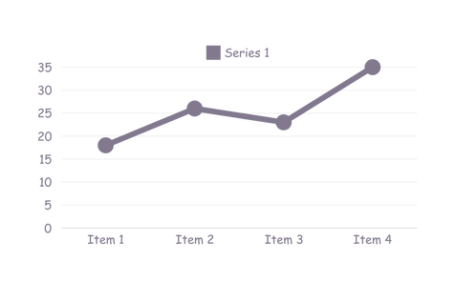
Experimental Analysis
Sentiment Analysis: Fine-tuned language models analyzed tweets to classify public opinion about Tesla. These models performed better than traditional tools.
Prediction Model: An LSTM model was trained to predict stock prices using both market data and sentiment scores, making it more effective in spotting patterns
over time.
Optimization: A bio-inspired Sparrow Search Algorithm was used to fine-tune
the prediction model, resulting in better performance and faster results compared
to older methods.
BACK
NEXT

Slide 9
Conclusion
This project demonstrates how combining advanced techniques like sentiment analysis and optimization can significantly improve stock price prediction. By using a fine-tuned Large Language Model (LLM) for sentiment analysis, the model was able to better understand the complex emotions behind tweets about Tesla, leading to more accurate predictions. Additionally, applying the Sparrow Search Algorithm (SSA) to fine-tune the LSTM model’s parameters made the prediction even more precise. These methods together reduced errors and increased prediction accuracy.
BACK
NEXT

Slide 10


References
[1] Frank Cao Yun ”Stocktwits 2020 2022 Raw”.
[2] Shihab ”Twitter Elbagir and Jing Yang Sentiment Analysis Using Natural Language Toolkit and 4 VADER Sentiment ”
[3] Humza Naveed, Asad Ullah Khan, Shi Qiu, Muhammad Saqib, Saeed Anwar, Muhammad Usman, Naveed Akhtar, Nick Barnes, Ajmal Mian ”A Comprehen sive Overview of Large Language Mod els”
[4] Tim Dettmers, Artidoro Pagnoni, Ari Holtzman, ”QLoRA: Luke Zettlemoyer Efficient of Quantized LLMs”
[5] Greg Van Houdt, Carlos Mosquera , Gonzalo N´apoles ”A Review on the Long Short-Term Memory Model”
[6] Petro Liashchynskyi, Pavlo Liashchyn skyi ”Grid Search, Random Search, Ge netic Algorithm: A Big Comparison for NAS”
[7] Jiankai Xue and Bo Shen ”A novel swarm intelligence optimization ap proach: sparrow search algorithm”
BACK
NEXT

Slide 11
THANK YOU

